Slide 1
Classification of Fishing Activities using ResNet Neural Network from AIS Data
Lorenzo Medici and Mirko Simoni

Slide 2
Introduction
The purpose of our project revolved around the studying of fishing ships activities in the Mediterranean Sea.
We wanted to design a computer system able to classify the different type of fishing techniques adopted by several vessel.
We did so by using the information gathered by the ships electronic equipment, also known as Automatic Identification System (AIS)

Slide 3
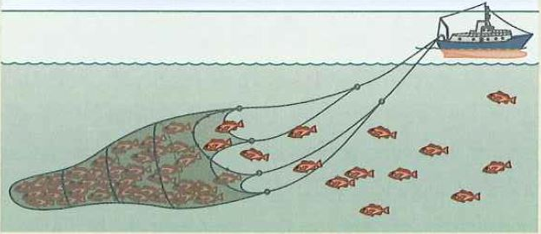
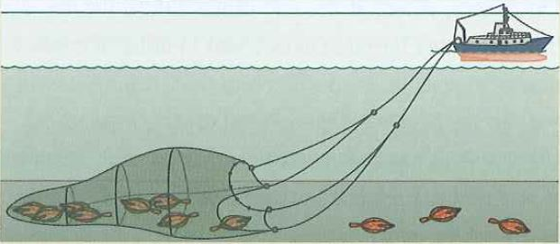
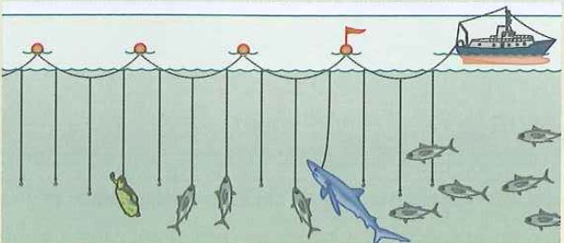
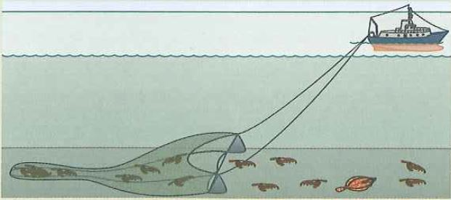
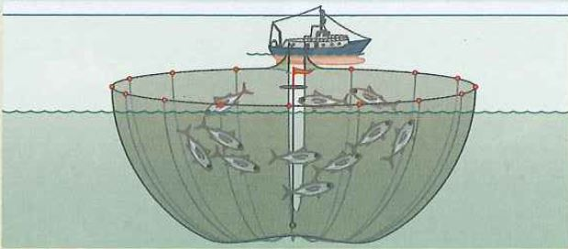
Fishing gear and techniques to classify
Pelagic Pair Trawl (PTM)
Bottom trawls (OTB)
Long lines (LL)
Beam Trawl (TTB)
Purse seine nets (PS)

Slide 4
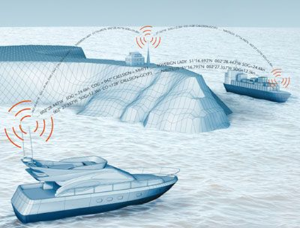
AIS data
Ships are equipped with an automatic tracking system that uses transponders to transmits every 5 minutes vessel’s position, identity, speed, course and many other relevant information to all other AIS devices within range.

Slide 5

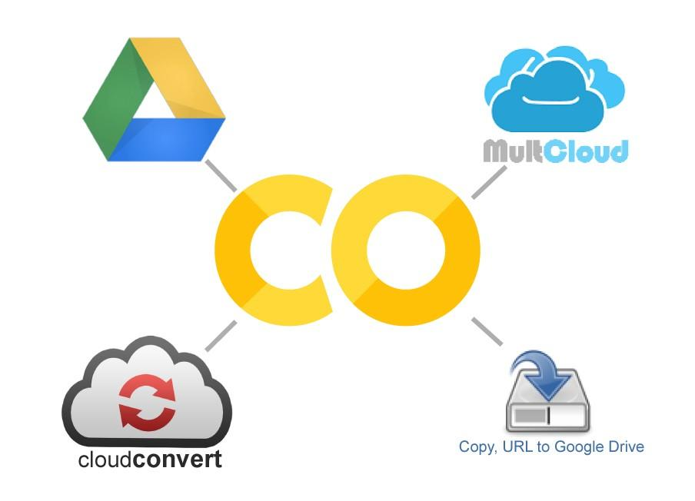

Technologies adopted
We used the following softwares for our goals:
pgAdmin 4
Matlab
Google Colab

Slide 6
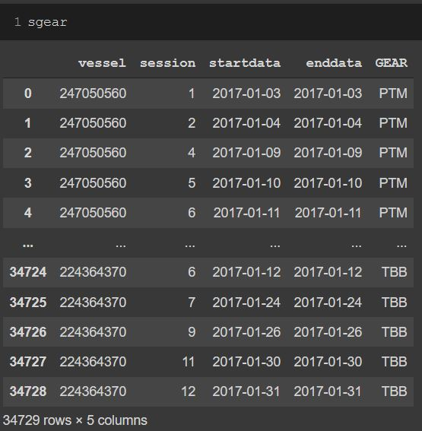
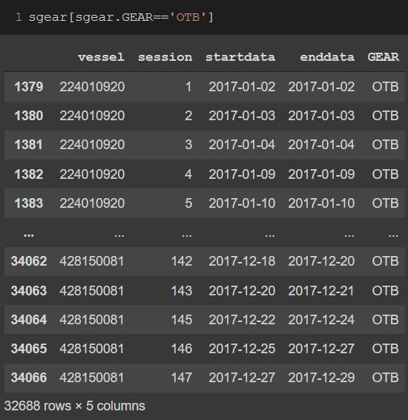
Dataset balancing
Dataset with all GEAR
Dataset with only OTB

Slide 7
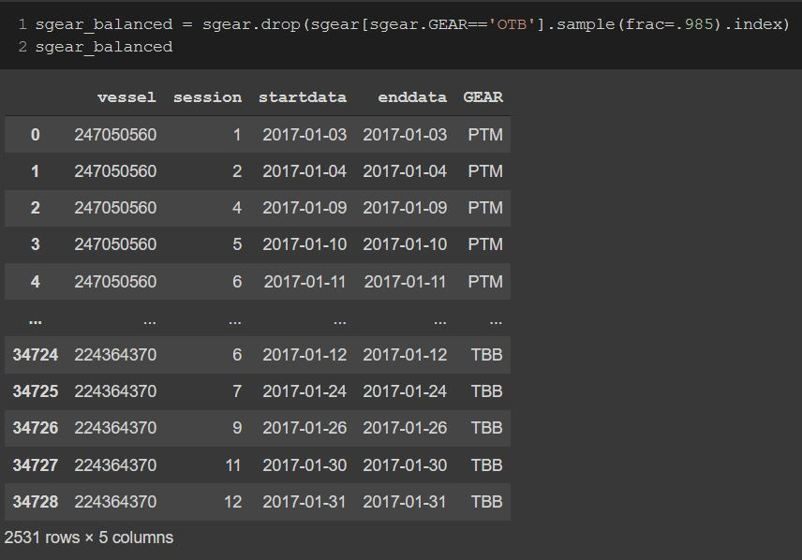
Dataset with OTB balanced

Slide 8

Dataset filtering
Many sessions within the dataset where created merging two or more sessions together, in order to have enough pings for the session to be usable.
Unfortunately, those kind of data proved to be unreliable, thus we filtered them away and left only those session with the “joined” column equal to zero.

Slide 9
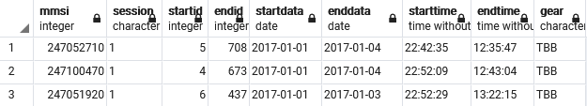
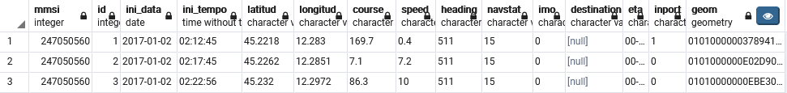
Dataset structure
session_per_gear.csv
dataAIS.csv (dati raw)

Slide 10
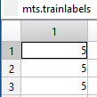

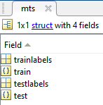


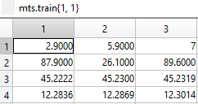
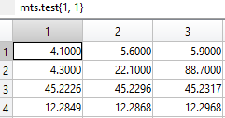
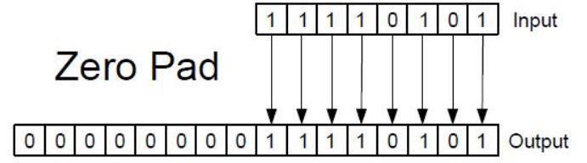
Multi-class time series structure
FULL TIME SERIES
GROUND TRUTH
(training and testing sets)
FEATURES USED (speed, course, latitude and longitude)
Time series have different length
Solution

Slide 11
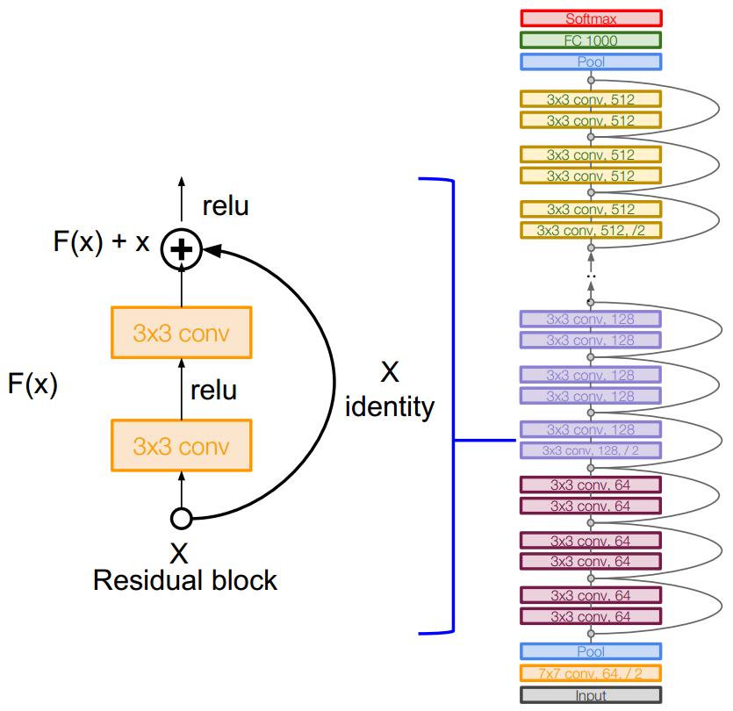
ResNet architecture
Skip connections
Allow avoiding overfitting

Slide 12
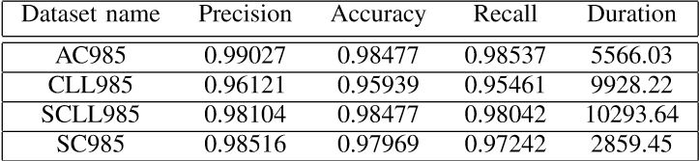
Results
The network appears to work better when the speed feature is present within the dataset.
This is likely due to the overall small variations of speed from one ping to the next in comparison with the other features, such as latitude and longitude.

Slide 13
Conclusion and future works
ResNet neural network works brilliantly for classification of Multi-class time series, despite the nature of the dataset, reaching accuracies and precisions above 95%
Another feature to use in the future for the classification is the measure “jerk”, which is calculated as the derivative of the acceleration
The same network and data manipulation process can be adopted for solving different problems in other scientific fields of research concerning data recognition and forecast of repetitive human activities.

Slide 14
Thank you for your attention

